Slide 1

Electric Vehicles Sales Drivers
Case study:
Washington state EV Demographics
February 2021
Analysis By:
F. Barillas & M. Morales

Slide 2
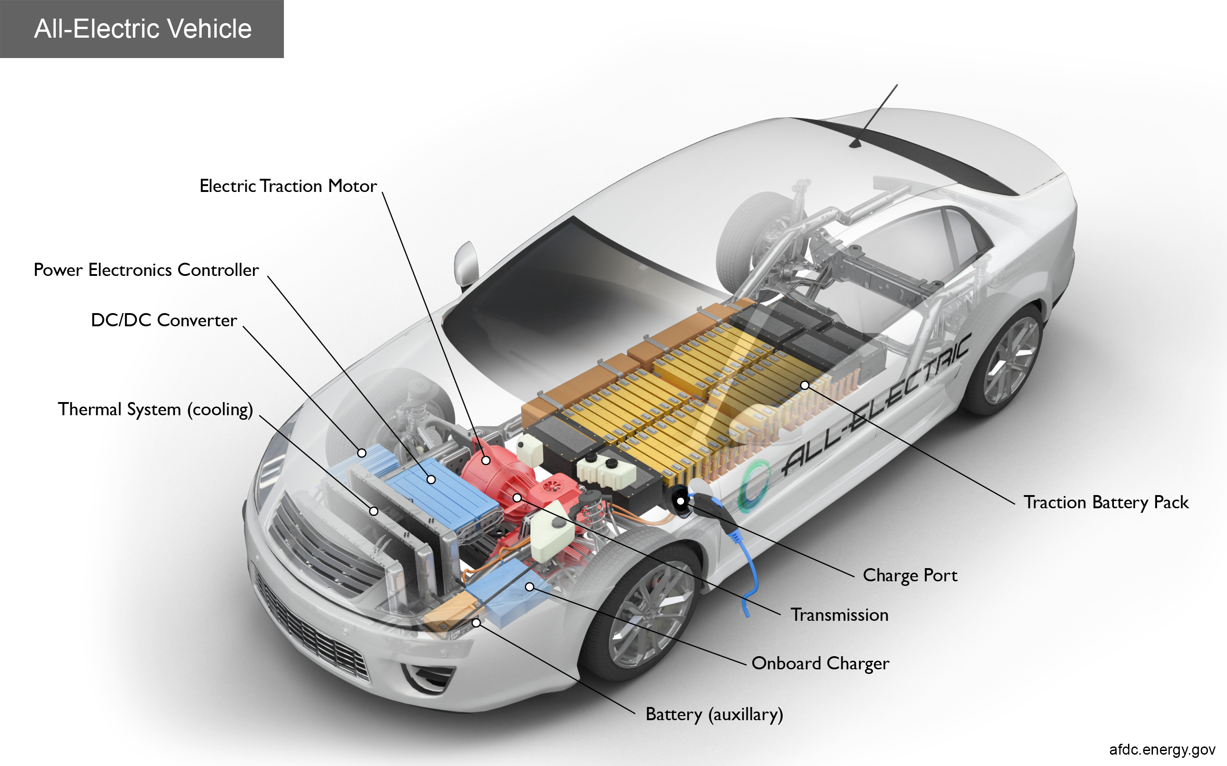
Fundamental Question: What drives market share in the electric vehicle marketplace?
According to McKinsey’s Automotive and Assembly Practice, the AGR% of electric vehicle global sales has dropped from 65% in 2018
to 9% in 2019.
While the growth continues positively in Europe and Asia, the market in the USA seems to have taken a respite from the accelerated growth of the past three years.
Nevertheless, there are signs that a new wave of sales is in the making fueled by government subsidies and other benefits.
Consequently, it is critical for a manufacturer of EV’s to understand what drives the popularity of a make and model in the marketplace.
This analysis includes the evaluation of EV sales in the Washington State for the period 2010-2021 against five different factors:
MSRP
Driving Range
Population
Surface Area of its Vicinity
Cost of Electricity in its Vicinity

Slide 3
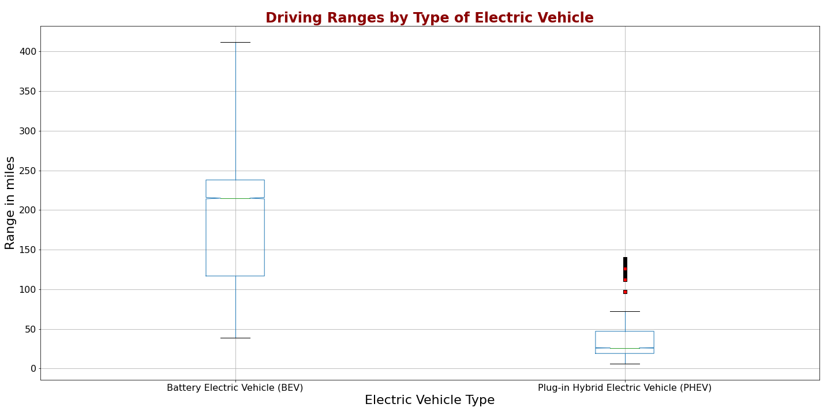
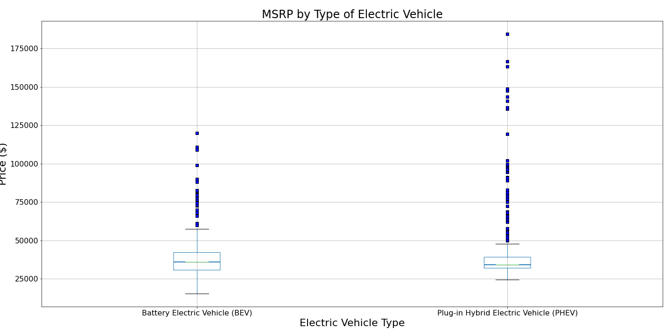
Washington State EV’s
Summary of Data Set
Over 64,000 vehicles
46,005 Battery Electric Vehicles (BEV)
18,427 Plug-In Hybrid Electric Vehicles (PHEV)
38 Manufacturers Represented
24 BEV Manufacturers
City and County of Registration
Geolocation
Vehicle Identification
MSRP
Driving Range
Significant difference in Driving Range
Between BEV’s and PHEV’s

Slide 4
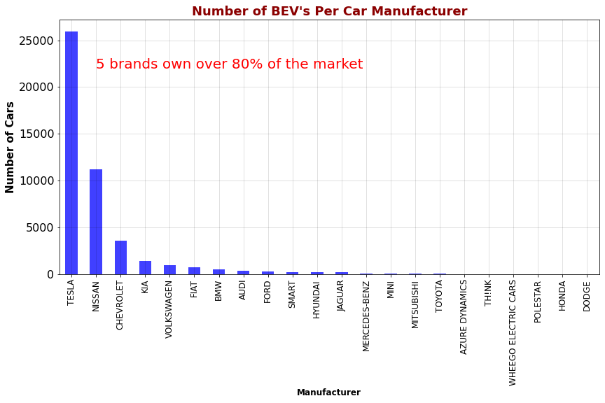
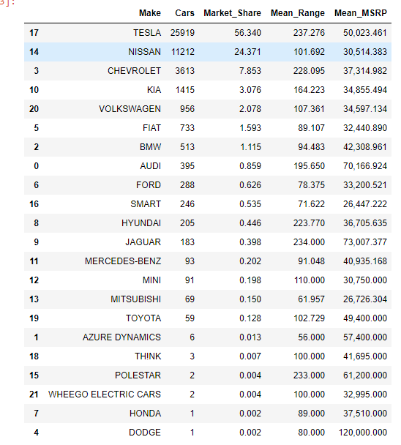



Market Share

Slide 5
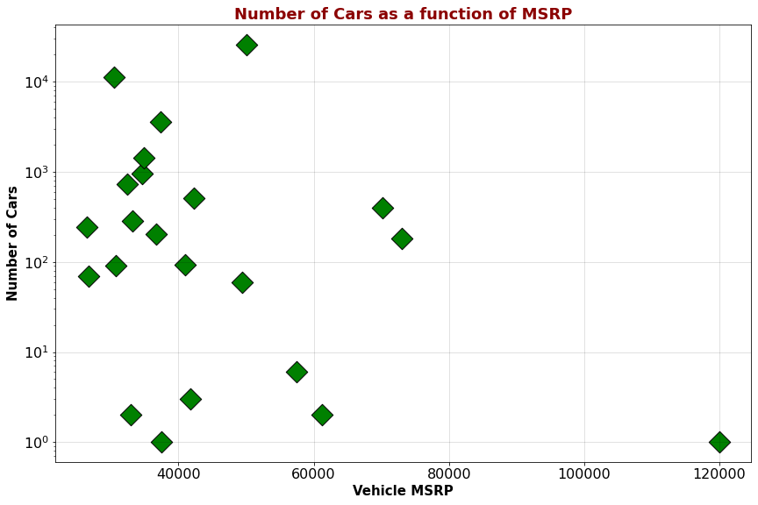
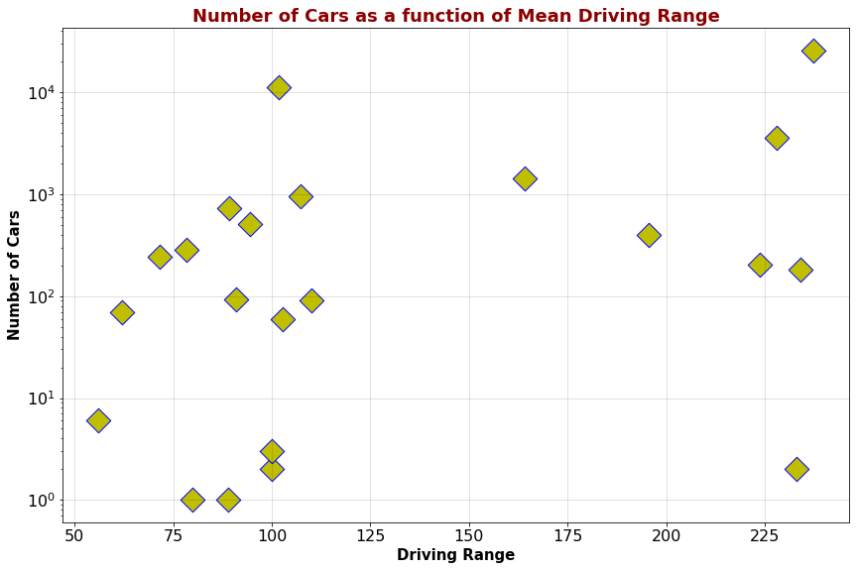
So, What Drives Market Share?
Pricing
Range

Slide 6
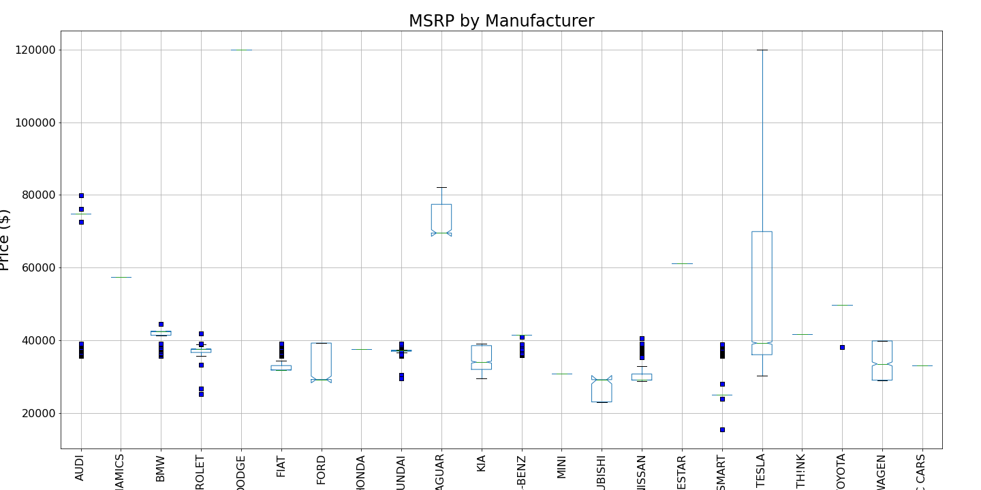
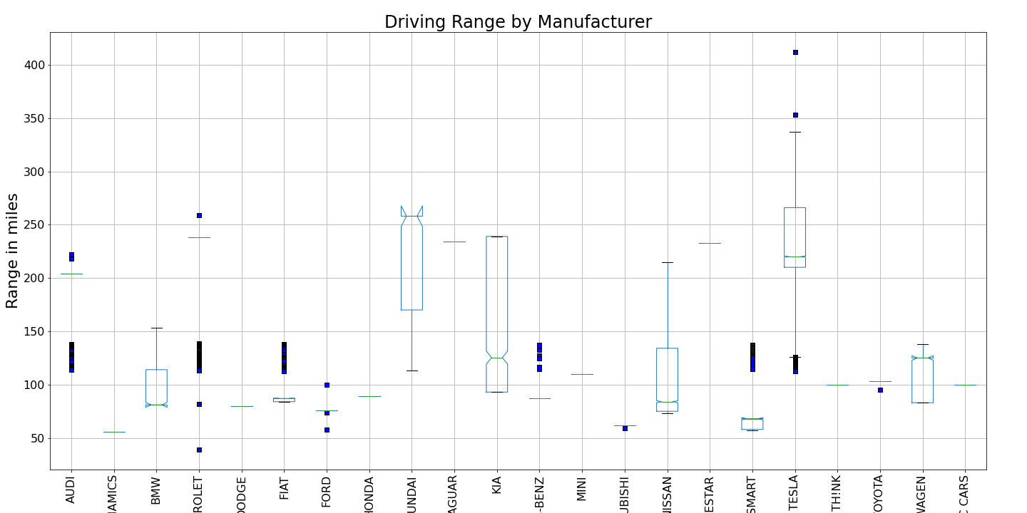
Manufacturers Performance
Pricing
Tesla leads in the range category with increasing new capacities in 2020 and 2021.
Tesla’s new affordable model stretches is presence in the price category as well.
Hyundai, Kia, and Chevrolet are competitors worthy of consideration given their price competitiveness and increasing range performance.
Driving Range

Slide 7
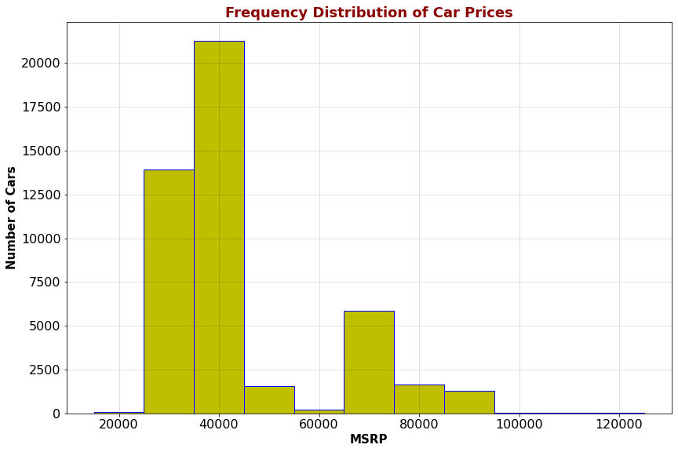
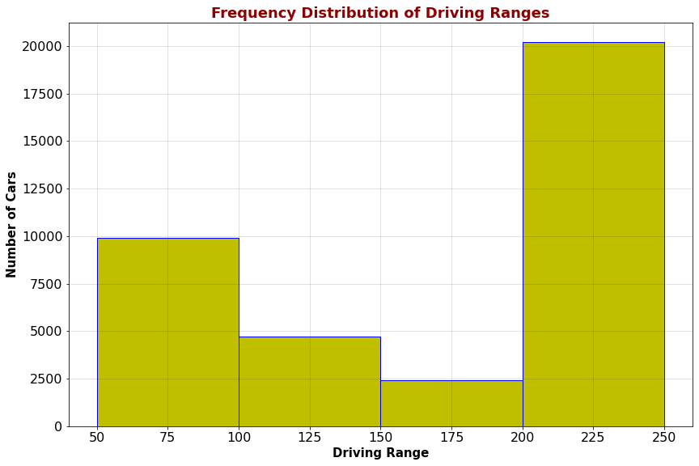
BEV’s in the Market
Pricing
Range

Slide 8
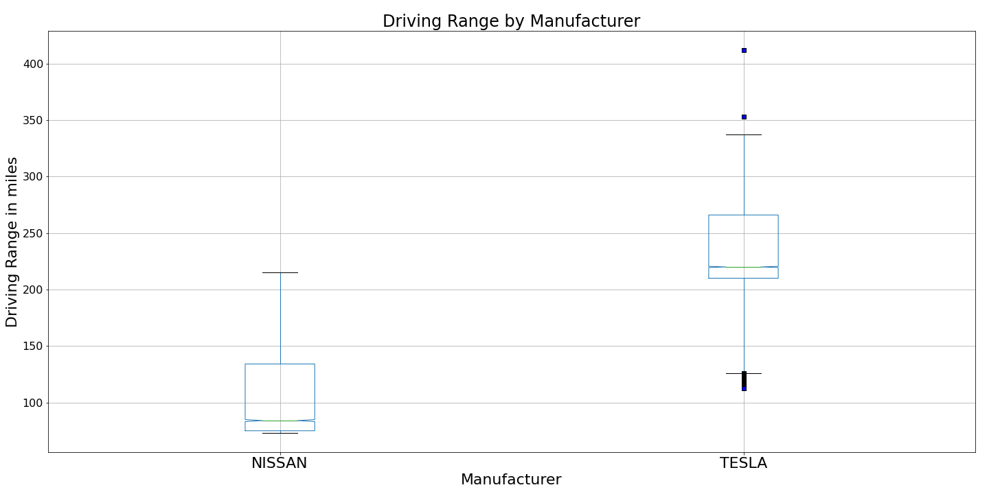
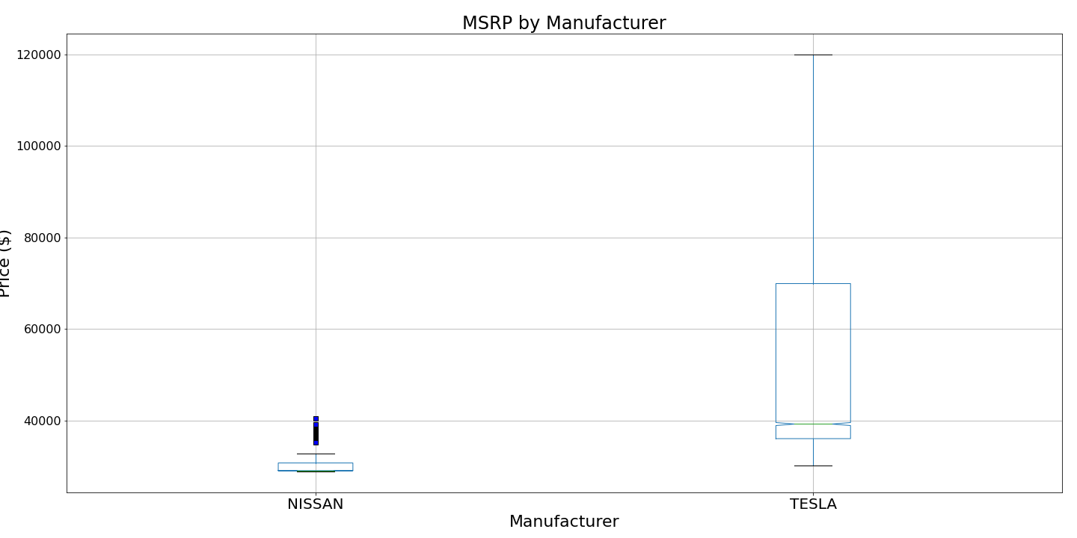
Comparing the Two Top Players: Tesla and Nissan
While Tesla models sold are consistently higher price than Nissan’s Leaf, Tesla outsells Nissan 2:1
Tesla Cars: 25,919
Nissan Cars: 11,212
The key differentiator is driving range, in addition to superb brand recognition and marketing.

Slide 9
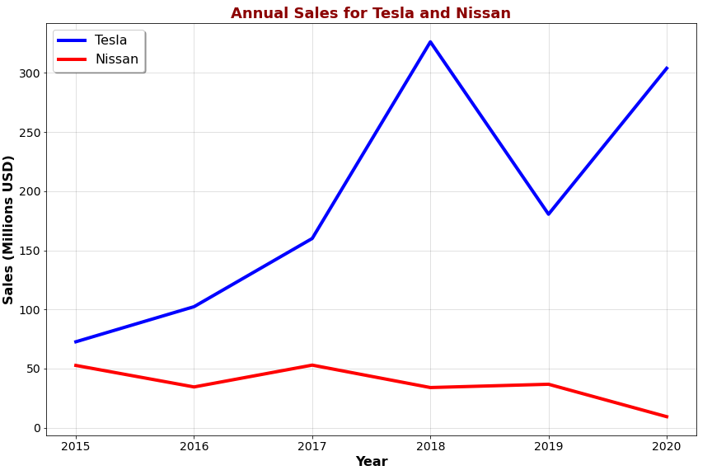
Sales Performance
For the past five years, Tesla has outsold not only Nissan but every other BEV manufacturer.
Furthermore, as Nissan’s Leaf sales plummeted in 2020, sales of Tesla models rebounded from the slowdown of 2019.
Tesla’s dual prong strategy of expanding driving range while making entry-level models more affordable in terms of price is likely to protect and even grow their market share.

Slide 10
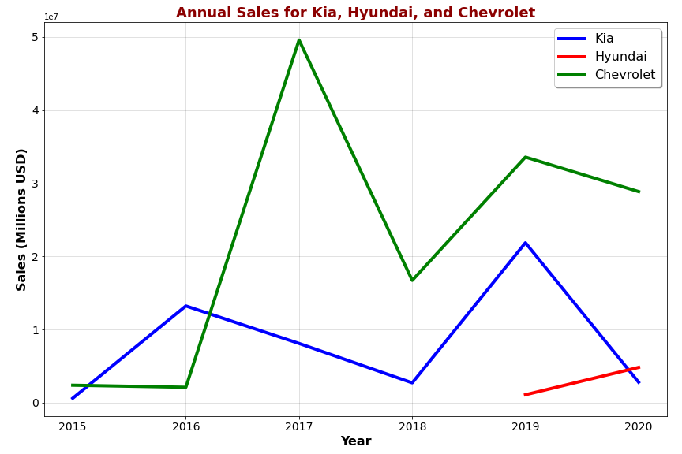


The Up and Comers
Increasing Battery Range
Solid Price Positioning
Makes these three manufacturers potential winners in the market:
The challenge for these manufacturers in 2021 and beyond is the redefinition of their value proposition for the market.
They must invest in better performing batteries while improving their model's attractiveness for the consumer.

Slide 11
Merging Environmental Factors Datasets
Extract Cars
Per County
Electric Cars
County
Demographics Dataset
Key Field: County
Electric Power
Rates Dataset
Key Field: County
Charging Stations Dataset
Key Field: County
Cars
Per
County
DataFrame
Key Field: County
Demo
Dataset

Slide 12
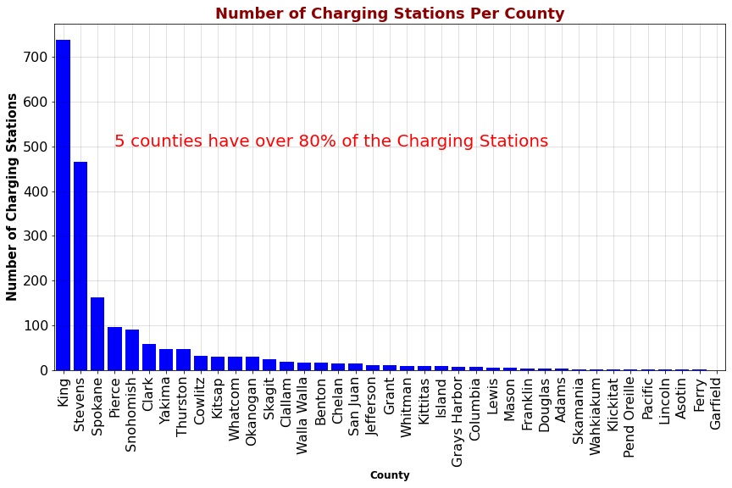
Is Number of Charging Stations Important?

Slide 13
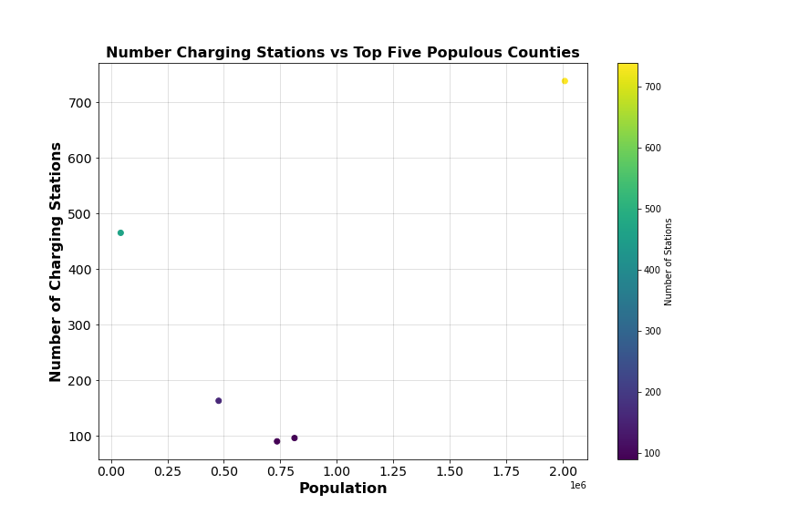
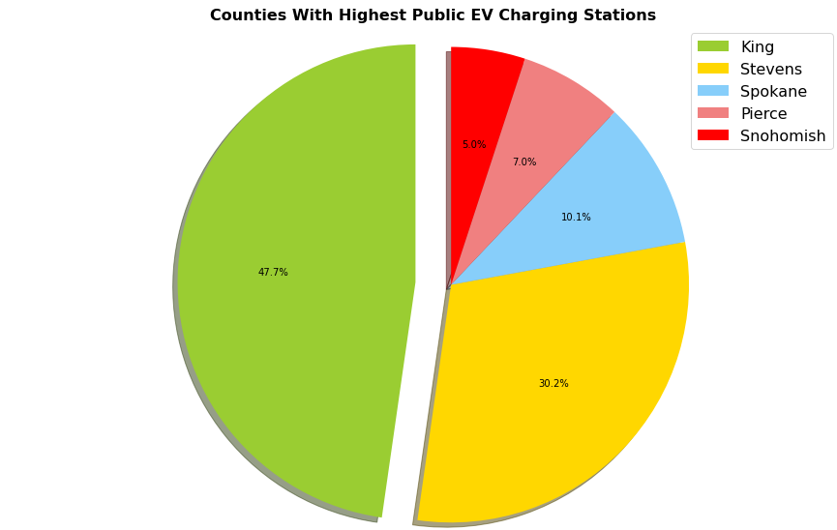
The Top Five Counties

Slide 14
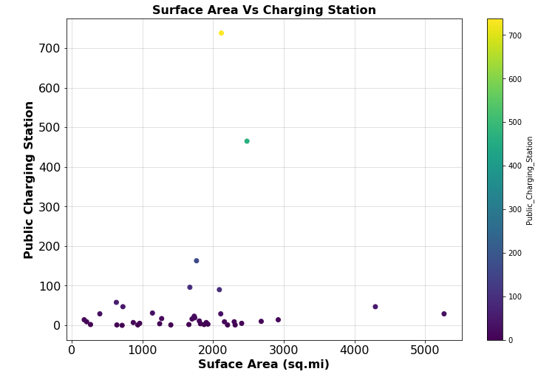
Does Distance to Drive Make a Difference?
There is a slight positive correlation between the surface area of the county and the number of charging stations available.

Slide 15
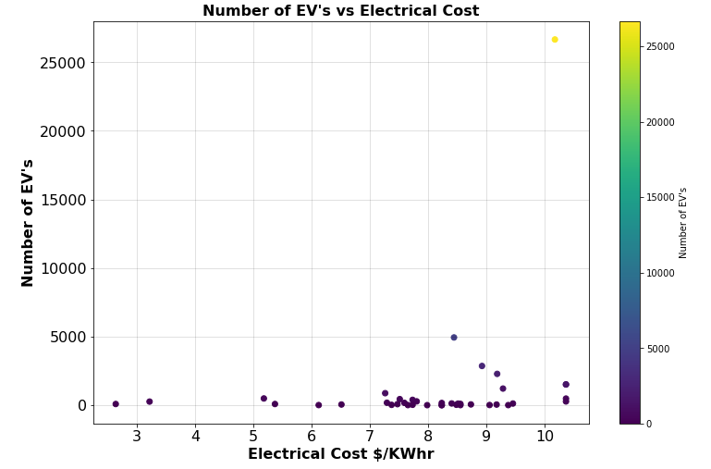
Does the Cost of Electricity Influence Buyers?
There are more cars in areas with higher electric costs than in areas with lower electric rates.
This positive correlation negates the notion that consumers take electric cost as a consideration for investing in a BEV.
It also speaks to the low cost of electricity compared to the fluctuating cost of gasoline.

Slide 16
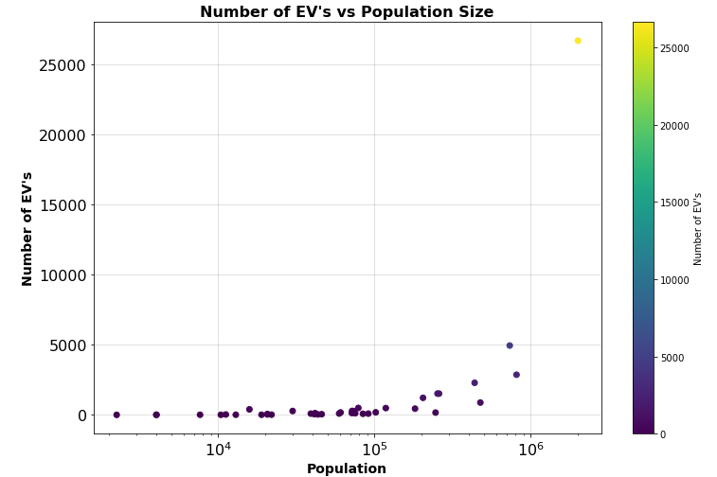
More People, More Cars?
There seems to be a positive correlation between the size of the population and the number of BEV’s.
It would be important to normalize this measure to verify the level of correlation between these two variables.

Slide 17
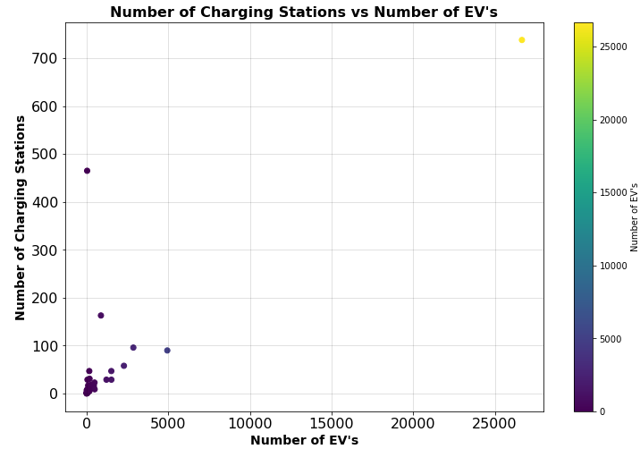
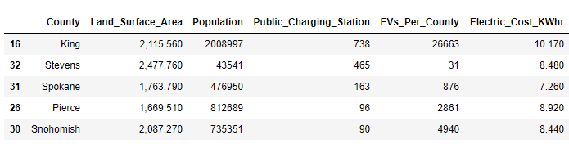
Charging Stations Drive Number of Cars?
There seems to be a positive correlation between the number of BEV’s in the county and the number of charging stations within it. However, there is one outlier that will require further analysis.

Slide 18
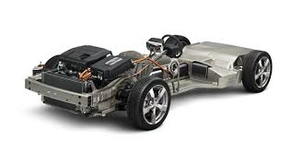
Conclusions
The factor with the most weight in the consumer purchase of an EV is its driving range. Nevertheless, Tesla’s undisputable dominance can also be attributable to exceptional brand management and car model appeal to different market segments.
Caveats
This analysis is limited to BEV in the state of Washington. It should not be extrapolated to encompass the rest of the United States.

